Slide 1
Line-based Feature Matching and 3D Reconstruction for Textureless Environments
高橋研究室
1730116
YU Zhengnan

Slide 2
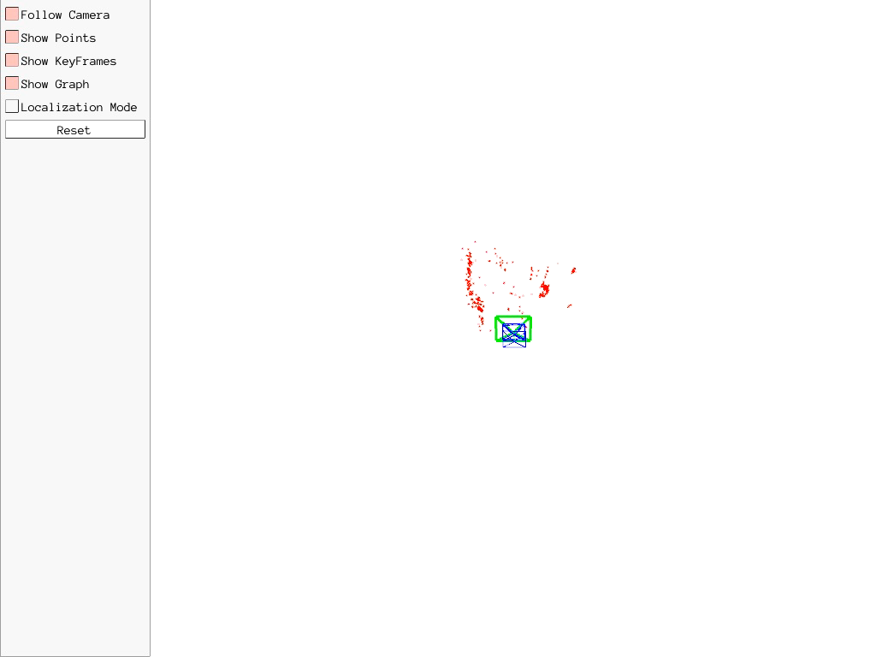
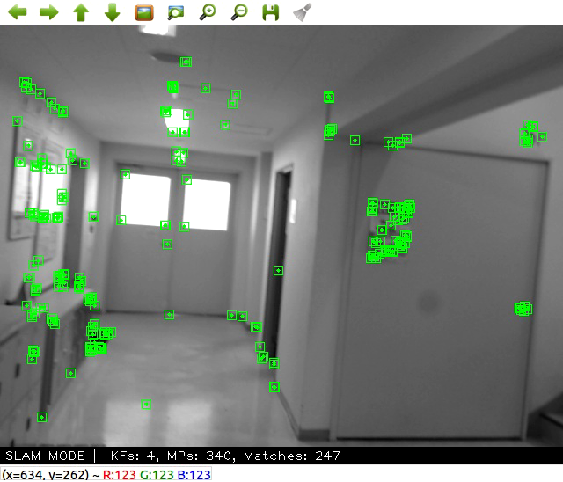
Background
Simultaneous Localization and Mapping(SLAM)
ORB-SLAM[Mur 15]
Fig1. Example of ORB-SLAM

Slide 3
Goal
Real-time 3D reconstruction solution
Applicability in textureless environment

Slide 4
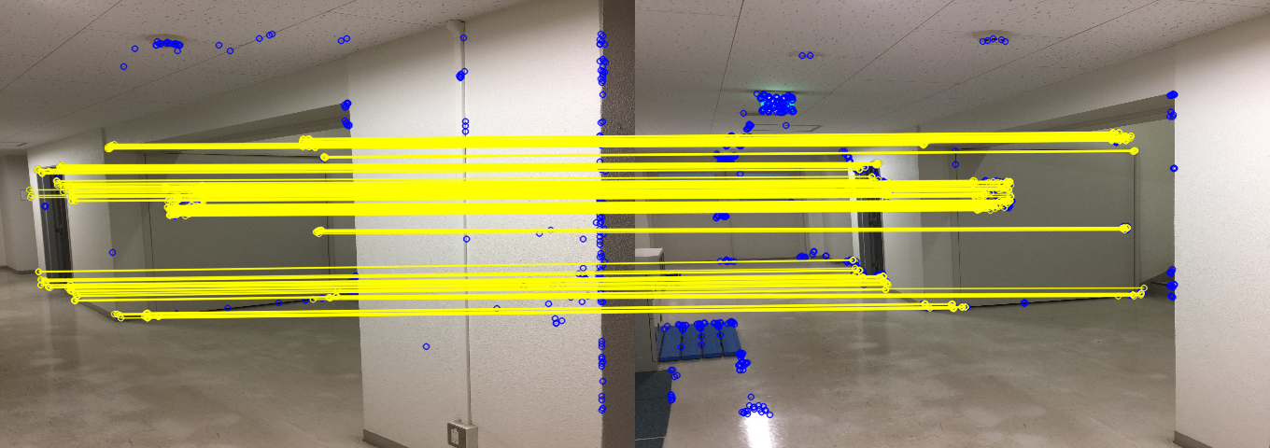
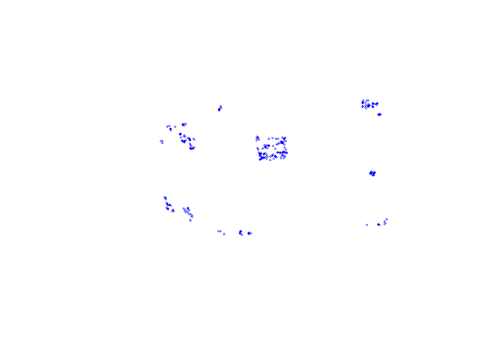
Related works
Oriented FAST and Rotated BRIEF(ORB)[Ethan 11]
(a) Matching result of ORB
(b) Corresponding key-points
Fig2. Matching result of textureless images

Slide 5
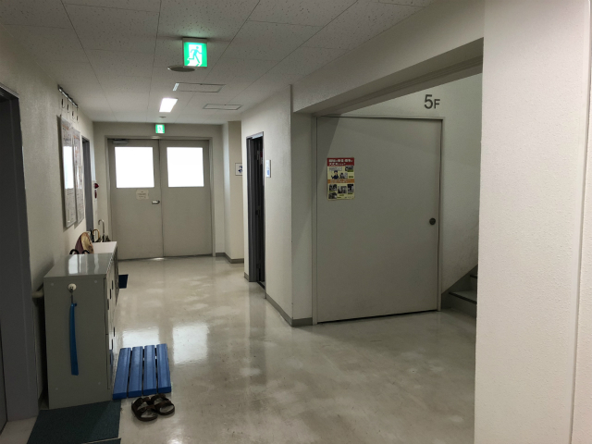
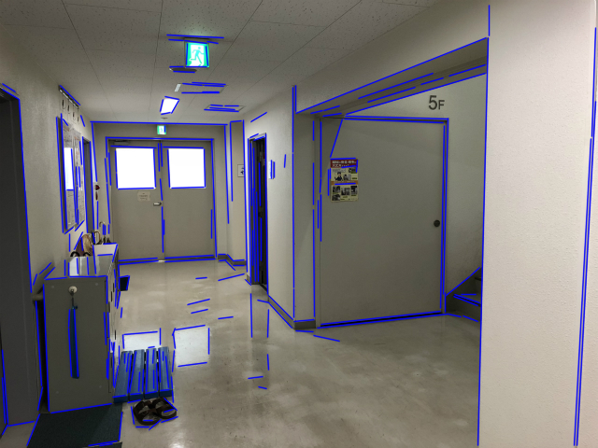
Related works
LSD[von 12] for line segment detection
Fig.3 Input image.
Fig.4 Detected segments in input image.

Slide 6
Overview
3D reconstruction by monocular camera
Feature
Matching
Pose
Estimation
Depth
Calculation

Slide 7

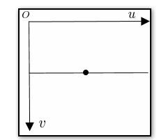
Local region normalization
Normalization of segments
Fig.5 Normalization of segments.

Slide 8
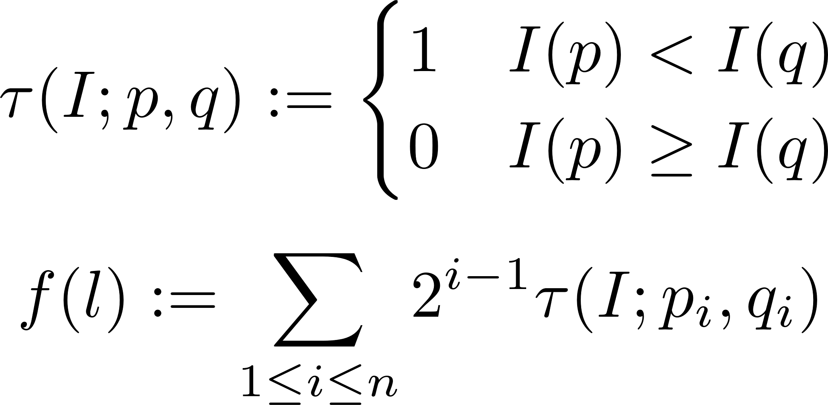


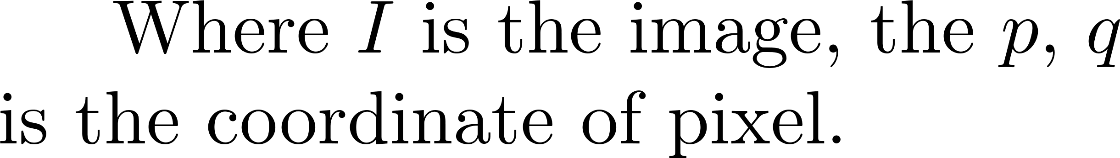
Segment matching
BRIEF[Calonder 10] descriptor for segment
 | p
Fig.6 Average filter.

Slide 9
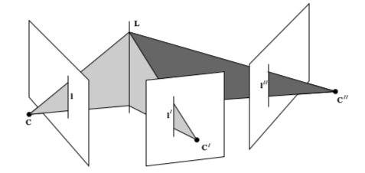
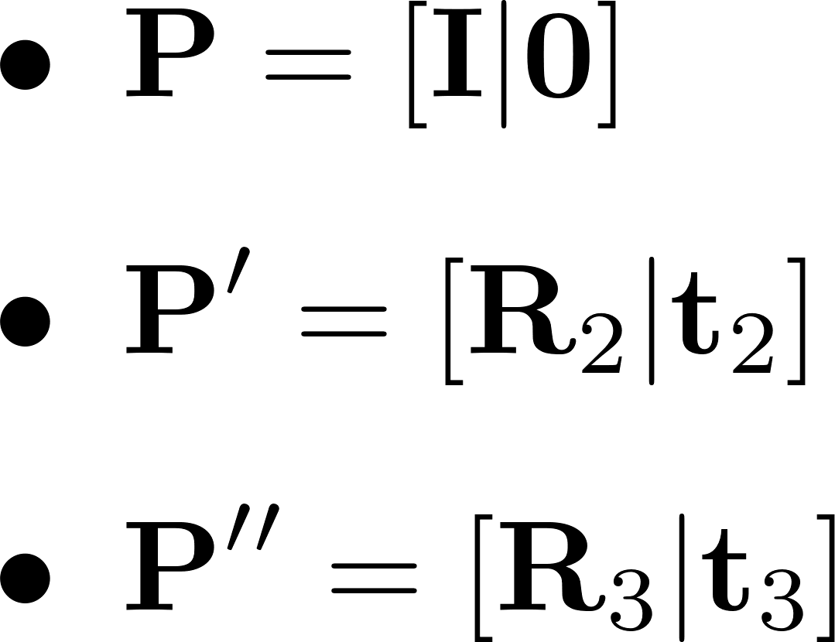
Camera pose estimation
Trifocal tensor
Fig7. 3D line L viewed from three camera poses.

Slide 10
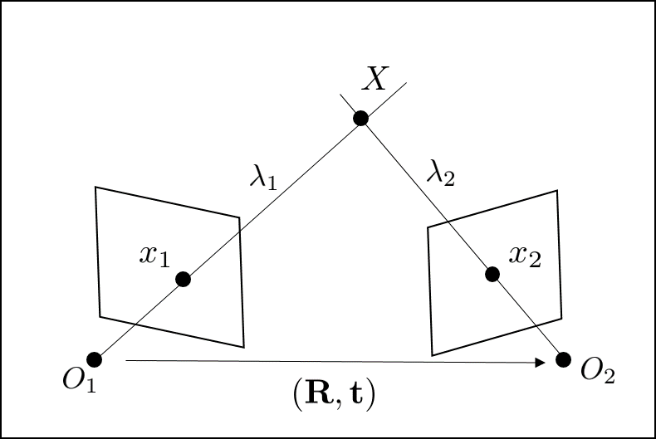


Triangulation of points
Fig8. Epipolar geometry for Triangulation.

Slide 11











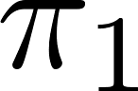
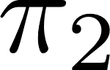




Estimation of line
Known parameters
Camera center: ,
End-points: , , ,
Transformation: ,
Fig9. Geometry correspondence of 3D line L.

Slide 12


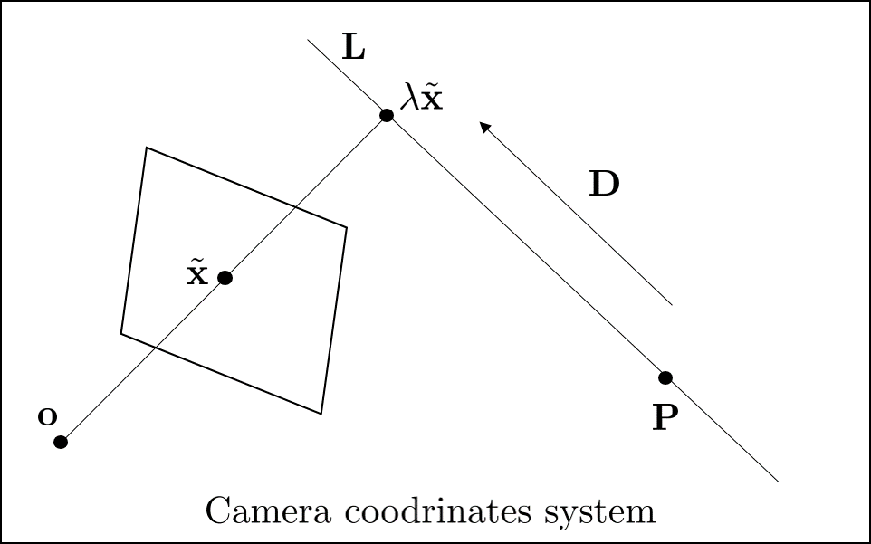
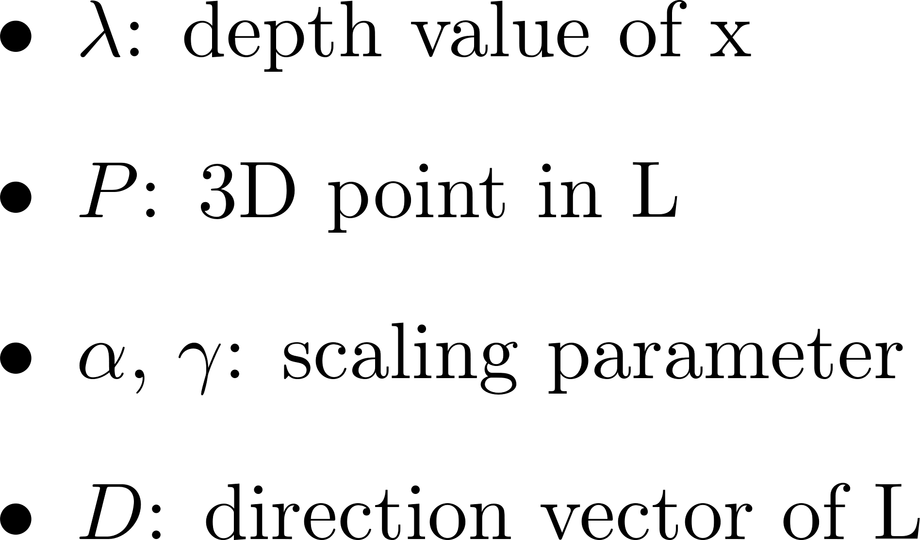
Depth computation
Depth of each end-point
Fig10. Computation of depth value.

Slide 13
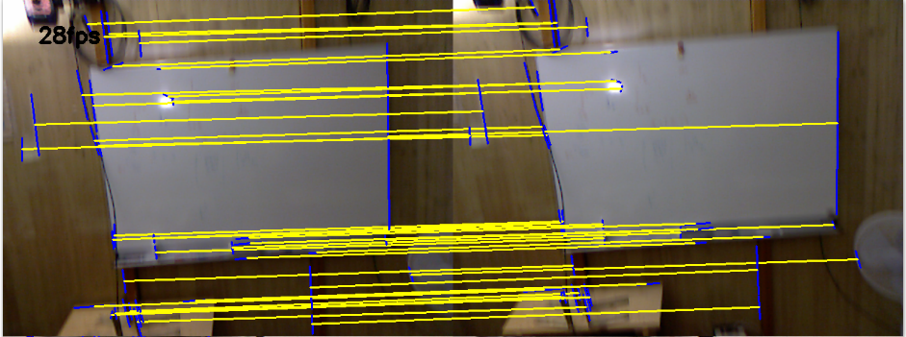
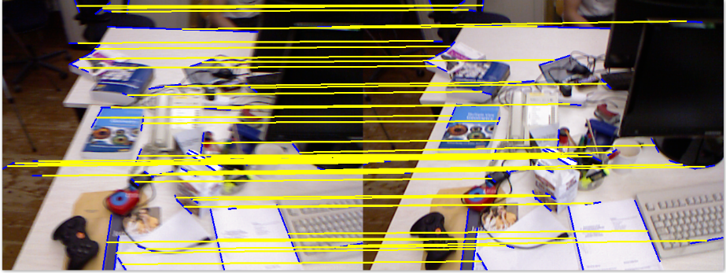


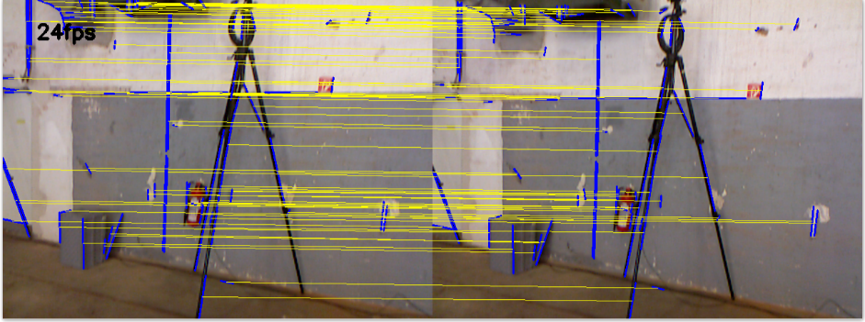
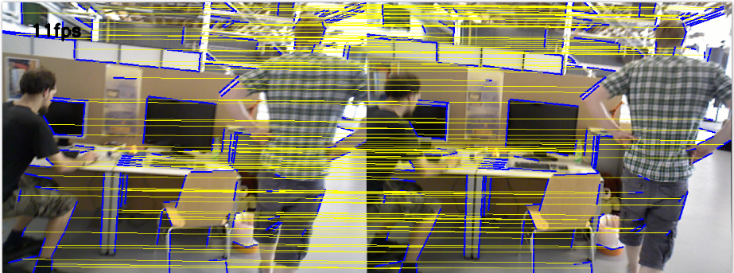
Experiments of segments matching
Fig11. Matching results of image sequences from RGB-D SLAM dataset[sturm 12].

Slide 14
Evaluation
Processing speeds(fps)
Fig12. Processing speeds of image sequences.

Slide 15
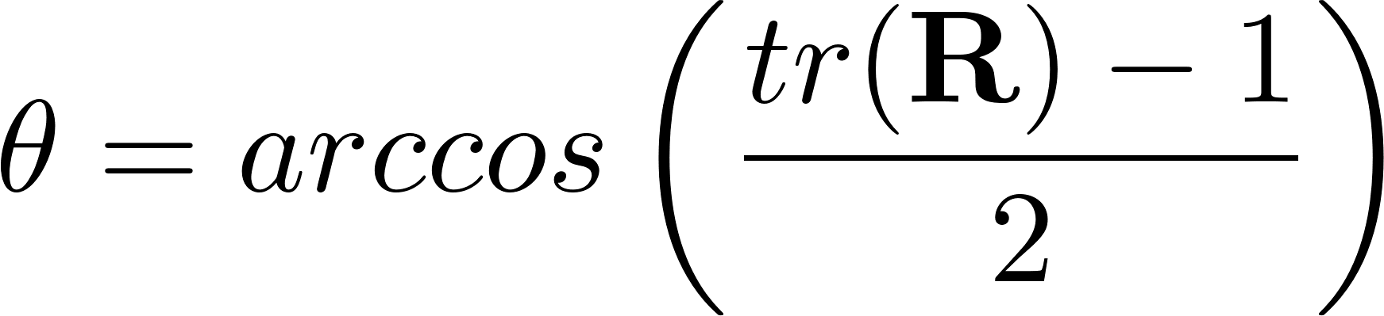



Evaluation of pose estimation
Rotation matrix to axis-angle
Fig13. Rotation errors of freiburg1_360.

Slide 16



Evaluation of pose estimation
Errors of translation
Fig14. Translation errors of freiburg1_360.

Slide 17
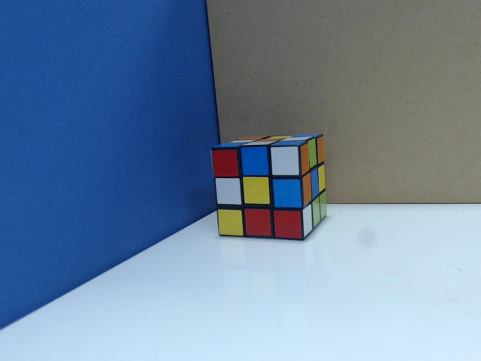
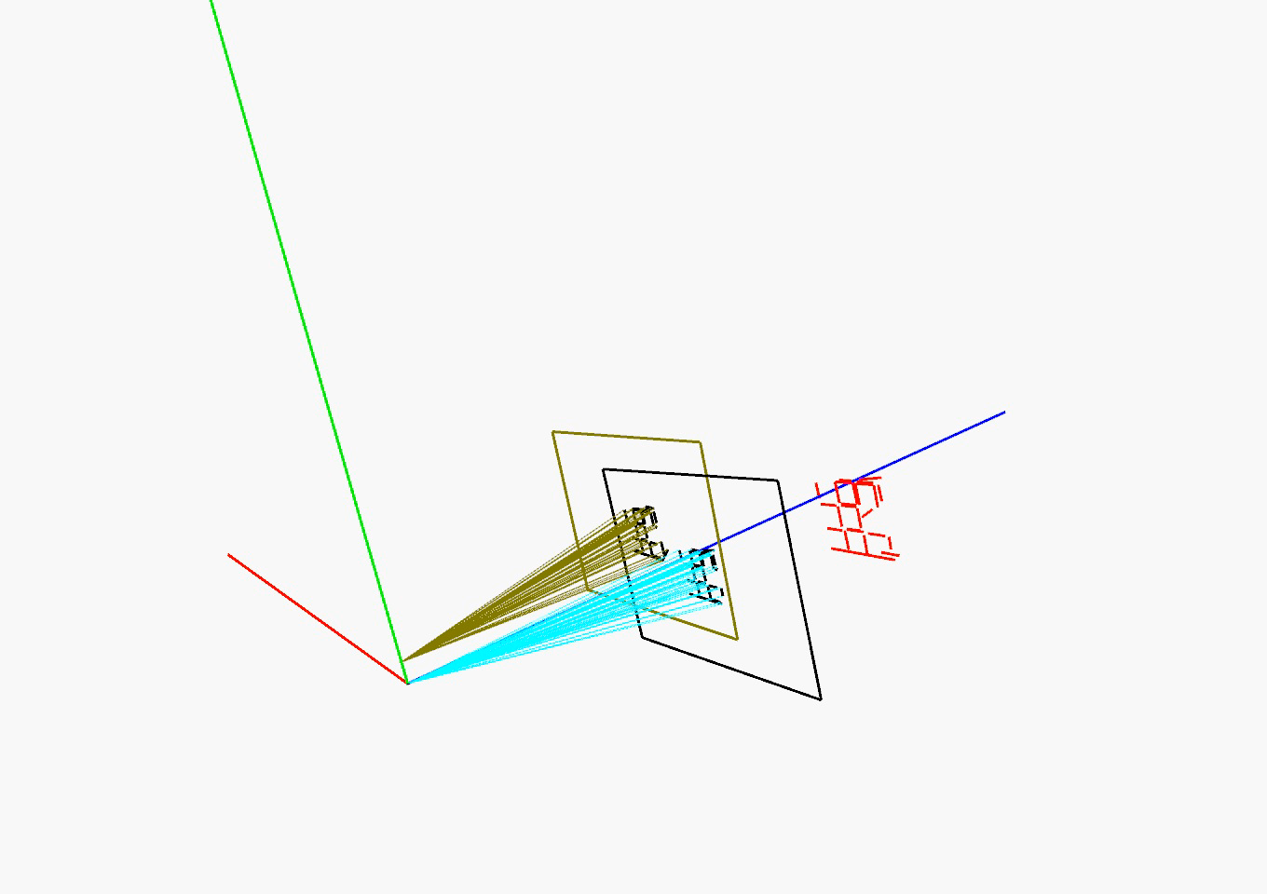
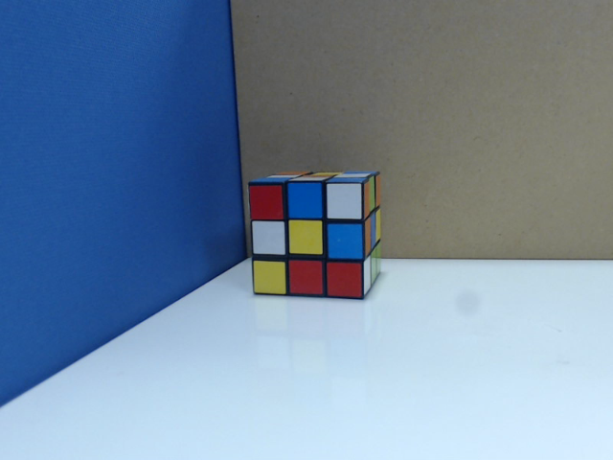
Result of 3D reconstruction
Fig15. 3D reconstruction.

Slide 18
Conclusion and future works
Conclusion
Real time segment matching
Depth computation method
Applicable to textureless environments
Future works
SLAM system by segments

